Slide 1


Slide 2

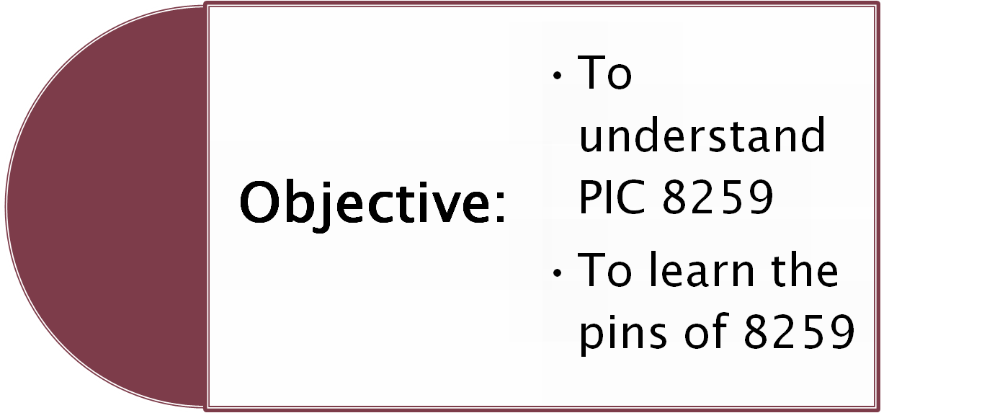

Slide 3
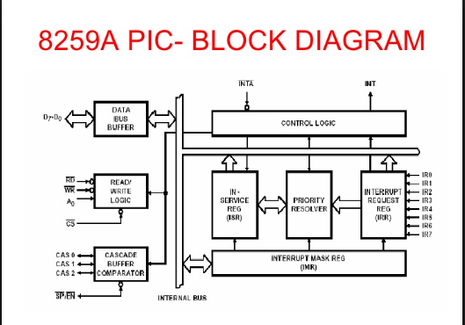

Slide 4

The Programmable Interrupt Controller (PlC) functions as an overall manager in an Interrupt-Driven system. It accepts requests from the peripheral equipment, determines which of the incoming requests is of the highest importance (priority), ascertains whether the incoming request has a higher priority value than the level currently being serviced, and issues an interrupt to the CPU based on this determination

Slide 5

Each peripheral device or structure usually has a special program or “routine” that is associated with its specific functional or operational requirements; this is referred to as a “service routine”. The PlC, after issuing an interrupt to the CPU, must somehow input information into the CPU that can point (vector) the Program Counter to the service routine associated with the requesting device

Slide 6

The PIC manages eight levels of requests and has built-in features for expandability to other PIC (up to 64 levels). It is programmed by system software as an I/O peripheral. The priority modes can be changed or reconfigured dynamically at any time during main program operation

Slide 7

Interrupt Request Register (IRR) and In-Service Register (ISR)
The interrupts at the IR input lines are handled by two registers in cascade, the Interrupt Request Register (lRR) and the In- Service Register (lSR). The IRR is used to indicate all the interrupt levels which are requesting service, and the ISR is used to store all the interrupt levels which are currently being serviced

Slide 8
Priority Resolver
This logic block determines the priorities of the bits set in the lRR. The highest priority is selected and strobed into the corresponding bit of the lSR during the INTA sequence.

Slide 9
Interrupt Mask Register (IMR)
The lMR stores the bits which disable the interrupt lines to be masked. The IMR operates on the output of the IRR. Masking of a higher priority input will not affect the interrupt request lines of lower priority.

Slide 10
Data Bus Buffer
This 3-state, bidirectional 8-bit buffer is used to interface the PIC to the System Data Bus. Control words and status information are transferred through the Data Bus Buffer.

Slide 11
Read/Write Control Logic
The function of this block is to accept output commands from the CPU. It contains the Initialization Command Word (lCW) registers and Operation Command Word (OCW) registers which store the various control formats for device operation. This function block also allows the status of the PIC to be transferred onto the Data Bus.

Slide 12
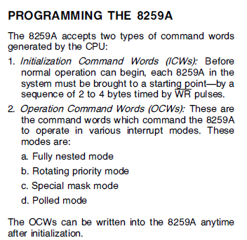


Slide 13

D[7..0] These wires are connected to the system bus and are used by the microprocessor to write or read the internal registers of the 8259.
A[0..0] This pin acts in conjunction with WR/RD signals. It is used by the 8259 to decipher various command words the microprocessor writes and status the microprocessor wishes to read.
When A0 is 1 WR operation follows

Slide 14
WR When this write signal is asserted, the 8259 accepts the command on the data line, i.e., the microprocessor writes to the 8259 by placing a command on the data lines and asserting this signal.
RD When this read signal is asserted, the 8259 provides on the data lines its status, i.e., the microprocessor reads the status of the 8259 by asserting this signal and reading the data lines.
INT This signal is asserted whenever a valid interrupt request is received by the 8259, i.e., it is used to interrupt the microprocessor.

Slide 15
INTA This signal, is used to enable 8259 interrupt-vector data onto the data bus by a sequence of interrupt acknowledge pulses issued by the microprocessor.
IR 0,1,2,3,4,5,6,7 An interrupt request is executed by a peripheral device when one of these signals is asserted.
CAS[2..0] These are cascade signals to enable multiple 8259 chips to be chained together.
SP/EN This function is used in conjunction with the CAS signals for cascading purposes

